Slide 1


Guidance Hub
This presentation outlines the development of a comprehensive mentor-student matching website, designed to connect students with experienced professionals in their field of interest.
by Surya Sanjan

Slide 2
Website Features
User Role Selection
Search for Mentors
Calendly Integration
Secure Video Call System
Users choose their role as either a mentor or student during sign-up.
Students can search for mentors based on their required skills.
View mentor availability and schedule appointments with automated email notifications.
Mentors provide a unique ID and password for secure video calls with integrated chat.

Slide 3






Technology Stack
Front-end
React.js
Backend
Node.js / Express.js
Database
MongoDB / MySQL .
Scheduling
Calendly API
Searching
Machine Learning

Slide 4
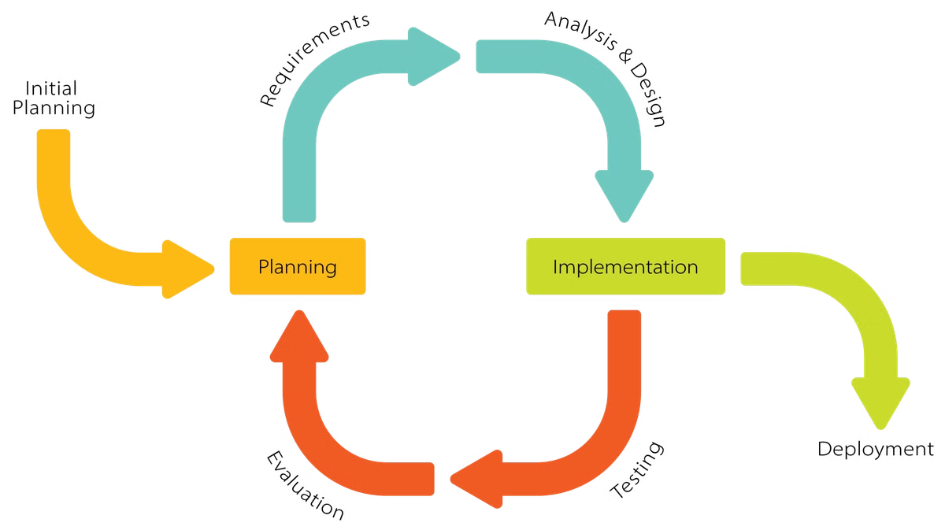
Iterative Development Model
1
Phase 1
Identify required attributes, such as skills and availability.
2
Phase 2
Plan and code the basic platform.
3
Phase 3
Integrate new functionalities, including Calendly and chat.
4
Phase 4
Test, improve, and iterate until the final version.

Slide 5


User Sign-Up Processes
Mentor Sign-Up Process
Details required: name, age, email, password, phone number, current position, location, skills, experience, resume, achievements.
Student Sign-Up Process
Details required: name, age, email, password, phone number, qualification, college, period of education, goals/ambitions.

Slide 6
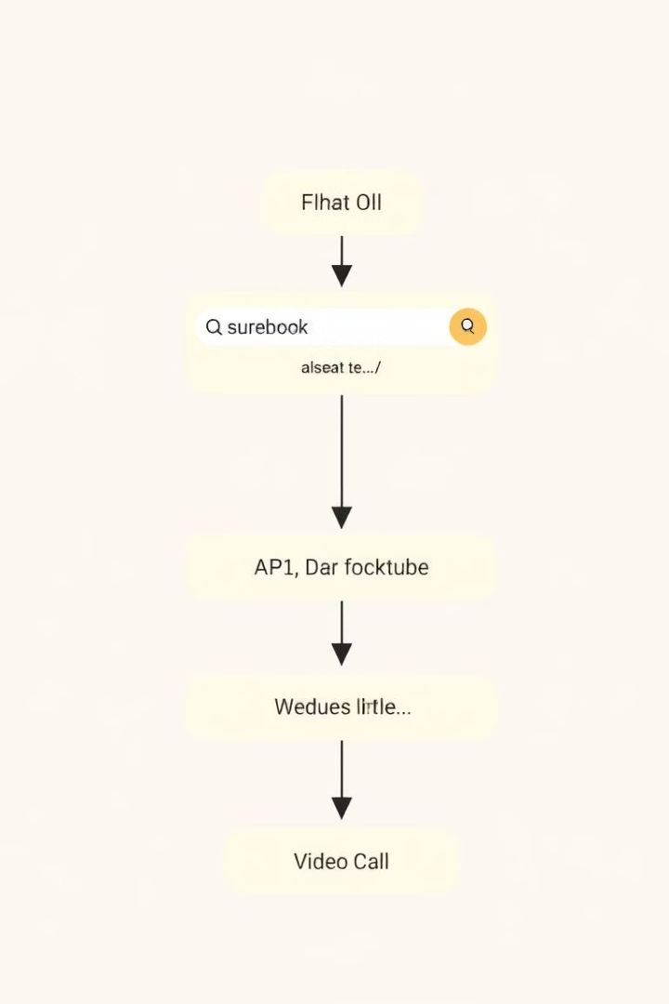




System Diagrams
User Input
Students enter their skills and preferences.
Search Query
The system processes the search query.
Calendly API
Integrates with Calendly to manage availability.
Video Call Process
Facilitates secure video calls with chat.

Slide 7



Recommender System
Model Input
1
Student skills and preferences.
Algorithm
2
Collaborative Filtering / Content-Based Filtering.
Model Output
3
List of suggested mentors.

Slide 8

Calendly Integration
1
Availability
Mentors update their availability, making it easy for students to schedule appointments.
2
Automated Emails
Appointment booking sends automated email notifications to both parties.
3
Conflict Prevention
Calendly prevents scheduling conflicts, ensuring efficient time management.
4
Rescheduling
Calendly allows us to be able to reschedule appointments with the mentors

Slide 9
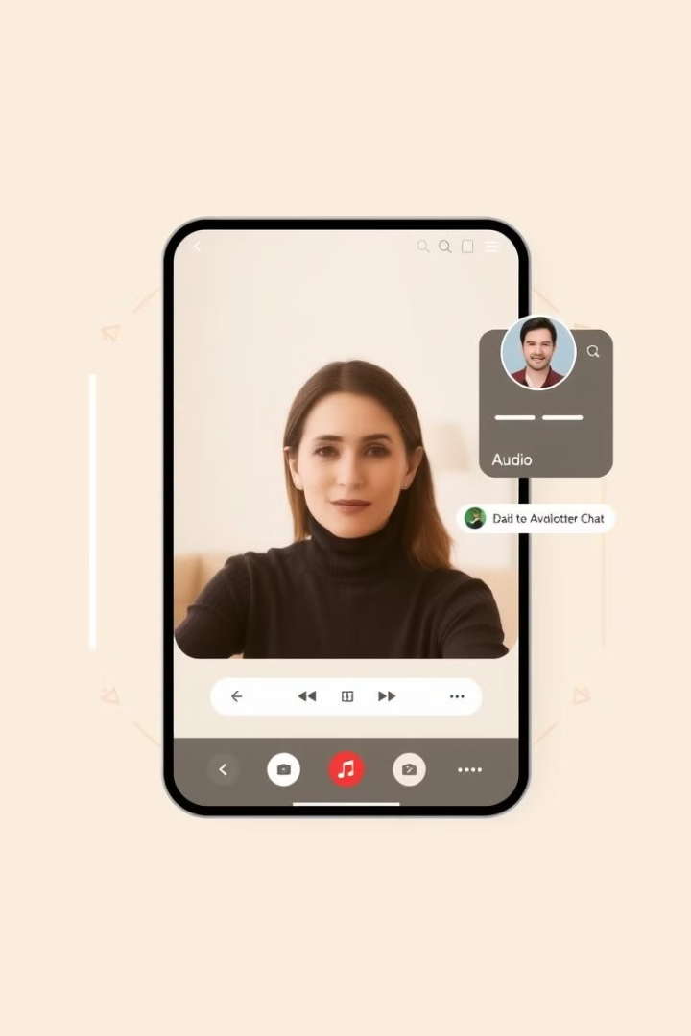



Video Call and Chat
Platform
Integrated video call API (sockets,WebRTC).
Access Control
Mentors provide a unique ID and password for secure access.
Chat Feature
Real-time messaging during video calls.

Slide 10
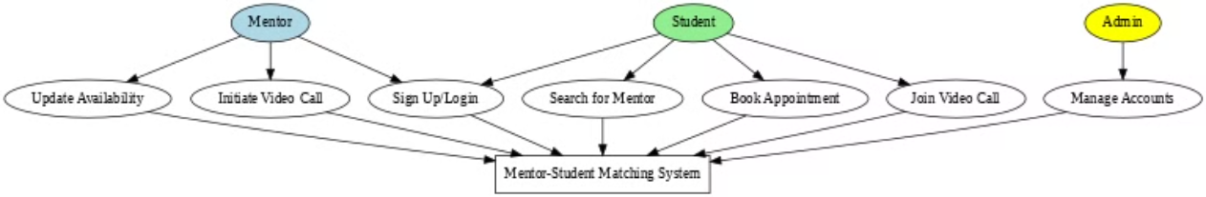
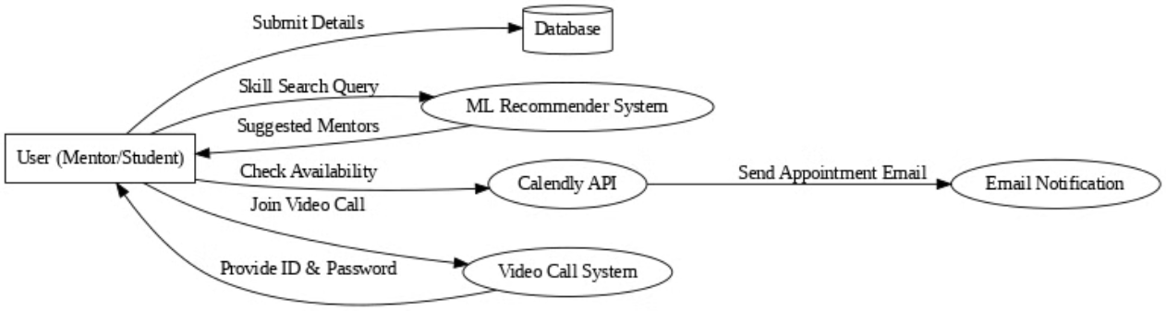
UML Diagrams
Use case Diagram
Data flow Diagram

Slide 11
Challenges & Conclusion
Challenges Faced
1
Integrating Calendly API, video call security, ML model efficiency.
Solutions Implemented
2
Followed documentation, added ID & password for restricted access, fine-tuned the model.
Conclusion
3
Successfully built a mentor-student platform with search, scheduling, and video call features.
Future Scope
4
Add group sessions or webinars, implement feedback for recommendation improvement.

